Slide 1

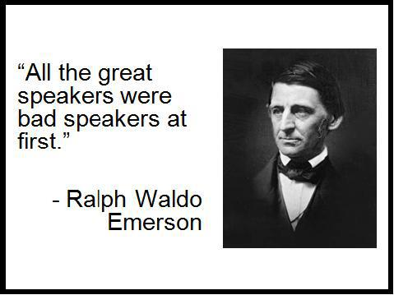
Non verbal communication

Slide 2
WE WILL DISCUSS:
Definition of the term.
Types of presentations
Presentation skills-types
Structure of presentation (overview)
7 steps in planning
Outlining the presentation
Organization of the presentation
Use of Audio Visual Aids.
Presentation delivery skills

Slide 3
SKILLS TYPES
Presentation skills can be divided into:
Presentation preparation skills
Presentation delivery skills

Slide 4
What are presentation skills?
Presentation skills can be defined as a set of abilities that enable an individual or a group to:
Carry out some purpose through polished communication.
Present information on a particular topic
Interact with the audience
Transmit the messages with clarity
Engage the audience in the presentation
Interpret and understand the mindsets of the listeners.

Slide 5
Types of presentations:
Information-giving. This is predominantly descriptive, Briefings, research/informative/progress/ feasibility/analytic reports, trainings, updates, changes in policies/procedures, etc.
Discursive/persuasive. Here you debate on the strengths and limitations of an approach or develop an argument, exploring and weighing up different perspectives, challenging your audience to accept a different viewpoint. Decide your ‘angle’ – are you for or against it, weight pro and cons? Pull your audience in, challenge and confidently debate.
Demonstrative. Tend to be used in the context of training: for example, when demonstrating your ability to illustrate your understanding of a technique or teaching a practical skill to others. (Craig, C., 2009)

Slide 6
SKILLS TYPES
Presentation skills can be divided into:
Presentation preparation skills
Presentation delivery skills

Slide 7
A. Presentation preparation skills-process
Before developing the presentation, we need to do pre-planning.
These skills can be divided into:
Planning (topic, purpose, and audience analysis)
Research and content generation
Organizing content and preparing an outline or a working script.

Slide 8
planning
Step 1: Understanding the topic
Narrow down its scope according to the time available and audience’s needs.
Develop a title and a statement expressing the thesis
Think about the topic and develop a central idea/thesis.
Develop a clear, specific, and well-crafted thesis.
Step 2: Determining the purpose/objective
Inform, persuade, advocate, entertain, motivate, inspire, didactic.
Purpose should be crystal clear to both the presenter and the audience- Consider both perspectives.
Think of the macro and micro perspective.
Macro refers to the explicit objective (Inform, persuade etc.)
Micro refers to the implicit objective (reaction form the audience.)

Slide 9
Planning
Sample Purpose Statement:
“To inform potential entrepreneurs about three important factors that loan officers consider before granting start-up loans to launch small businesses.”

Slide 10
Planning
Step 3: Audience Analysis
The hallmark of Business Communication is that it is reader-oriented and user-friendly.
The better you know your audience, the better you can connect with them to get the desired response
You may need the following information about them:
Designation (position in the hierarchy)
Technical/Professional Background
Gender, ethnocentrisms, culture etc.
Step 4: Time Allotted:
Consider the time allotted and prepare content that can only consume stipulated time.
Remember in business presentations, audience expect you to make your point within 20 minutes.

Slide 11
Planning
Step 5: Context Analysis:
According to context, choose style, content, communication strategies, language, and audio-visual aids.
Educational, professional and international conference i.e.
Number of attendees and seats, Lighting, and lighting controls, Audio/Visual equipment, Distracters, morning, evening, weekend.
Step 6: Medium Selection:
It can be a video recording, online presentation, live presentation, telephonic, etc.

Slide 12
Planning
Step 7: Research & Content Generation: Content planning.
By this time you should have a clear
Purpose
Topic
Thesis statement
Content Planning:
You need main points, supporting information, evidence, proof, facts, statistical data, etc for your presentation.

Slide 13
Planning-Content Planning:
Have in-depth knowledge of the topic.
Know the following dimensions of the topic:
Definitions
Major divisions
Key themes and ideas
Historical background
Aspects
Multiple perspectives on topic, supporting and refuting arguments.
Advantages and disadvantages
Societal importance
Future developments and implications.

Slide 14
Planning-Content Planning:
If your presentation is informative or persuasive, follow the steps below to gather content.
Begin with generating ideas yourself using brainstorming, journalistic questions, or whatever works best for you.
Start reading on the topic to develop a profound grasp on it.
3. Read samples, technical/business documents, business articles, research papers, books, etc. online or in a library.
4. Conduct interviews, observations if necessary.
5. Make notes during this research.
6. Gather all data and start critically reviewing them and select 3 main points.
7. For each main point, select supporting material.
8. Organize the material into an outline.
9. Use the outline form on the next slide as a presentation guide.

Slide 15
Planning-Content Planning Summarizing the imp. steps
Follow the given flow:
Brainstorm the topic again.
Research more.
Review and organize ideas and information
Organize ideas into an outline- Introduction, Main Body, Conclusion.
Develop a story-board.

Slide 16
Outline Form
Topic:
Purpose:
Audience:
Time:
Context:
Medium:
Central Idea:
Main Point 1:
Supporting material:
Main Point 2:
Supporting material:
Main Point 3:
Supporting material:
Conclusion

Slide 17
A.V. Aids and effective slides development

Slide 18
Why use AV aids?
Visual aids accomplish several goals:
• Make your presentation/speech more interesting
Reinforce what you say. Enhance understanding.
• Enhance your credibility as a speaker
• Illustrate, complement, and reinforce and supports your verbal claim.
• Communicate complex or intriguing information. Conjure/ visualize.
• Help the audience use and retain the information

Slide 19
What AV aids are usually used
PowerPoint slides
Overhead transparencies
Graphs/charts
Pictures
Objects/Models
Films/video
Flip charts
Sketches
Chalk or white board

Slide 20
Preparing Effective Slides
Emphasize key terms or important words by changing font style, type, size, etc.
Do not use paragraphs in slides. Just use headings, prompts, key points, and definitions in the slide.
Use only 4-6 lines of text per VA
Use phrases, not full sentences
Use Upper Case and Lower Case for ease of reading
Limit lines to no more than 30-35 characters

Slide 21

Preparing Effective Slides
Use pictures, charts, diagrams, tables,
videos, etc in your slides to achieve the following:
Explain points more effectively
Illustrate a point
Clarify a point
Offer evidence to support a point
Present a point more easily

Slide 22
Be Visible
Use Sans Serif fonts (fonts without feet)
e.g. Arial, Tahoma, Trebuchet, Verdana, etc.
Titles should be 32-44 pt. font size, BOLD
Text should be as large as possible
First level 24-32 pt font size
Second level 20-28 pt font size
Use color wisely- Contrasting colors
Aim for:
No more than seven words per line.
No more than seven total lines.
No more than 30-35 words per slide.

Slide 23

Use “eye Movement The ‘Z’ Rule” for the placement of content
Upper left
Upper right
Lower left
Lower right

Slide 24

Good slide vs Bad slide

Slide 25
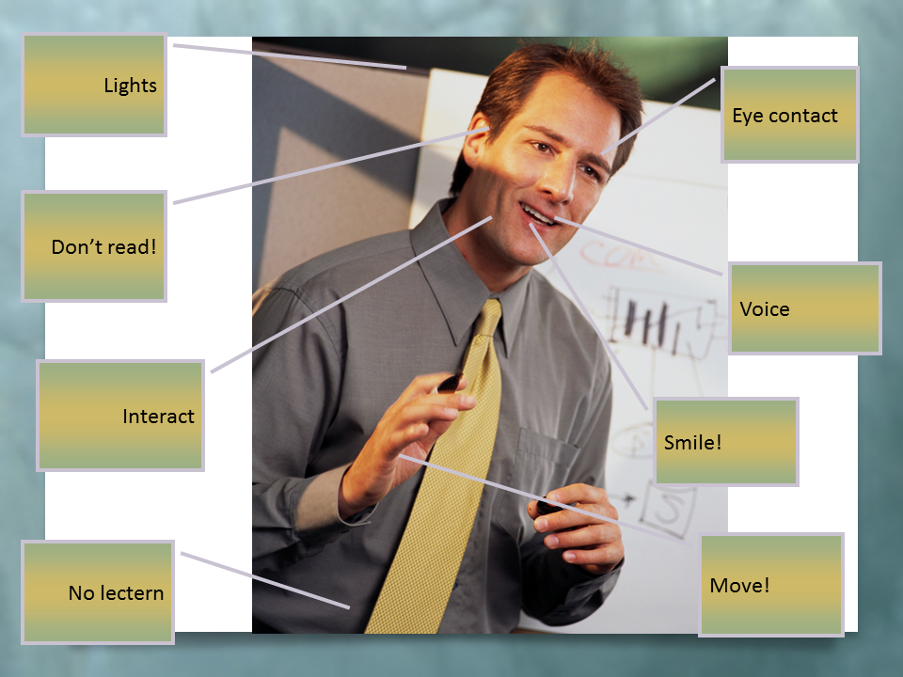
PRESENTATION DELIVERY SKILLS

Slide 26
STORYBOARD
Develop a storyboard first.
A graphically organized illustrations or images displayed in a sequence for the purpose of pre-visualizing a motion picture, animation, motion graphic or interactive media sequence.

Slide 27
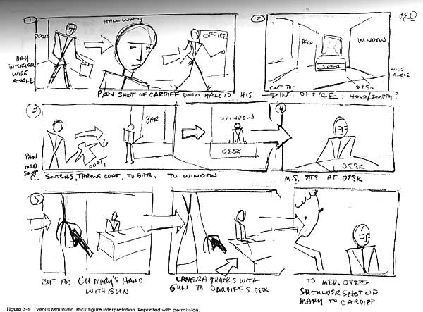
An example of Storyboard

Slide 28
Before Starting the presentation
Greet the audience.
Begin with handouts distribution, if any.
Grab audience attention by signaling the commencement.
Establish credibility by introducing yourself, you designation, your organization, etc.
All the above will help you build rapport.

Slide 29
INTRODUCTION
This is the most important part of the presentation.
You have to accomplish 4 objectives here which are:
Sharing the title.
Capturing audience attention
Generating interest
Giving a clear idea about the topic and purpose of the presentation.

Slide 30
MAIN BODY
Maintain the interest you aroused in the introduction.
Discuss each main idea in detail.
Develop connection between the ideas.
Follow one of the organizational patterns.
The order of information:
Topical
Chronological
Problem/Solution
Cause/Effect

Slide 31
MAIN BODY
Supporting evidence (it develops your points)
Examples, feedback & questions from audience (if necessary)
Attention to, and focus on, audience… are they listening?
Make your talk interesting by using
analogies, metaphors, similes, Logos, ethos and pathos, personal anecdotes, hypothetical scenarios
Use words of transitions or verbal sign posts to indicate shift from one point to the other.

Slide 32
CONCLUSION
Note that the listeners will remember conclusion more than any other part of the talk.
Inform audience that you’re about to close by using transitions like, to sum up, in the end
Restate thesis and summarize main points
“Tell them What You Told them.”

Slide 33
CONCLUSION
Something to remember, or call-to-action, give recommendations here
Note: Remember to end gracefully and focus on what you want the listeners to remember or do
Open the floor for Q & A session

Slide 34
Q & A session
Make sure that you understand the question thoroughly. Do not be impolite or rude if you get an offensive remark or question. You can use the following phrases:
I’m glad you asked that question…
That’s a good question/remark…..
I agree with you but there is another way of looking at things…….

Slide 35
Developing & Explaining points
Use support material like
Story, anecdotes, observations
Statistics
Facts
Hypothetical examples
Logos, ethos and pathos
Quotation
Analogies
Metaphors or similes

Slide 36
Presentation Delivery Skills-verbal and Non verbal.
TASK:
Red page Number 75 to 78 and share the information about presentation delivery skills.

